Slide 1

GitHub Agentic Workflows
TECHNICAL PREVIEW
MONA LISA
Made with By
Mascot
GitHub Next & Microsoft Research
GitHub
@pelikhan @dsyme @eaftan @mrjf @mnkiefer @moussaka @lpcox
Notes:
Hello and welcome to this session on GitHub Agentic Workflows!
My name is Mona Lisa, and I’m a Mascot at GitHub.
The project is a collaboration between GitHub Next & Microsoft Research & Azure Core Upstream.
It is a team effort so before I start, I want to thank:
All my brilliant colleagues – especially Peli who has been a constant source of knowledge and inspiration!
All our amazing contributors so far that have been actively involved from day 1. The code is open source.
Let’s look at our Agenda for today…

Slide 2


TECHNICAL PREVIEW
From Automation to Intelligence
GitHub Agentic Workflows
Demo
Q&A
Notes:
In the next 30 minutes, I want to:
First dive into the evolution of automation and talk about how we got here.
Then, I’ll introduce you to GitHub Agentic Workflows: What they are and how they can truly enable you.
Next, I want to do demo to show you: - How to install and use the cli to add the “Daily Repo Status” workflow from our Agentics collection. - How to setup a workflow agentically by prompting an agent (for an Issue Triage workflow). - How to run at scale from a centralized repository (for intelligent dependabot configuration rollout across an org).
We’ll close with a Q&A: Your time to ask any questions you might have but also feel free to approach me after the session.
Before we dive into what we’ve built, let’s zoom out to see how we got here and why…

Slide 3
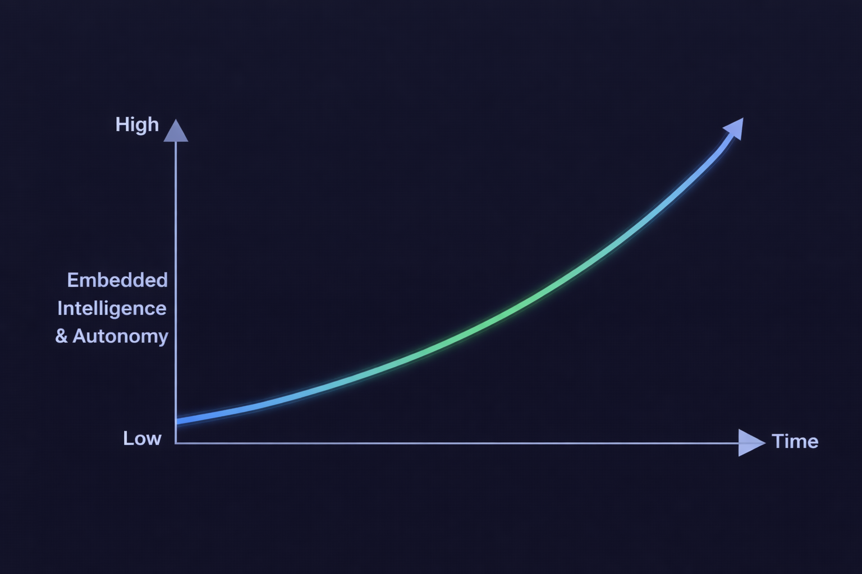


TECHNICAL PREVIEW
From Automation to Intelligence
Embedding intelligence into trusted workflows:
Automation is the foundation 2018: Launch of GitHub Actions
Copilot assists in the editor 2021: Launch of GitHub Copilot
Software Engineering (SWE) agents act on tasks 2025: Launch of GitHub Copilot Coding Agent
Agentic workflows with built-in intelligence 2026: Launch of GitHub Agentic Workflows
GitHub Agentic Workflows
EMBEDDED INTELLIGENCE
GitHub Copilot Coding Agent
GitHub Copilot
GitHub Actions
2018
TIME
2026
Notes:
Over the last decade, we have evolved CI/CD and optimized software delivery for reliability and speed.
Now we are starting a new journey! The graph (on RHS) shows how intelligence is being embedded into the software delivery system. What changes over time isn’t automation — it’s how much reasoning the system can do inside the workflow.
Looking at the GitHub Platform features, we can see how this evolved over time:
Automation is the foundation:
In 2019, GitHub Actions brought workflows directly into the platform: event-driven, versioned with code, explicitly triggered, and fully auditable. Execution was deterministic. The system runs pre-defined logic: no interpretation, no reasoning. Just state transitions. This model established trust and it continues to govern CI/CD today.
Copilot assists in the editor:
In 2021, GitHub Copilot introduced context-aware code completion. Repository context, human-in-the-loop review, etc. The model assists, the developer remains in control. Reasoning is introduced at the point of creation, but execution in our workflows remains deterministic.
Coding agent acts on tasks:
In 2025, the SWE (Software Engineering) agent awakened. Reasoning expanded from tokens to tasks. Multi-file context, goal-driven interaction, repository awareness. The system can decompose intent but still operates within explicit boundaries.
Agentic workflows run with intelligence built-in:
Agents operate inside CI. Actions trigger validation. guardrails constrain scope. All changes are observable and auditable. Deterministic systems provide enforcement, while intelligent systems provide adaptation. We’re not replacing deterministic systems; we’re layering probabilistic reasoning on top of them.
GitHub Agentic Workflows makes this possible. Let’s dive into what they are in more detail…

Slide 4
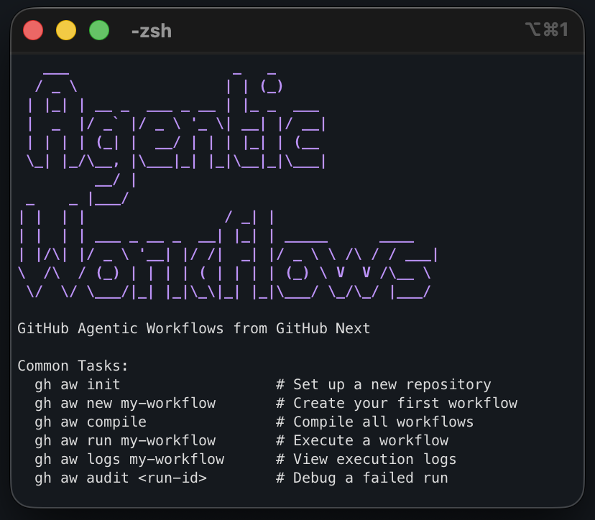
TECHNICAL PREVIEW
GitHub Agentic Workflows
Safely combine GitHub Actions & SWE agents using our Command Line Interface (CLI).
Prerequisites:
AI Account - Assumes GitHub Copilot by default
GitHub Repository - A repository where you have write access
GitHub Actions enabled
GitHub CLI (gh) v2.0.0+
Operating System: Linux, macOS, or Windows with WSL
Setup: Install the GitHub Agentic Workflows CLI gh extension install github/gh-aw
Notes:
GitHub Agentic Workflows brings AI-powered software engineering agents into GitHub Actions. Instead of introducing a separate automation system, this approach extends the CI/CD platform teams already use and trust.
The GitHub Agentic Workflows CLI acts as the control surface for setting up and managing agentic workflows. The CLI provides a guided setup experience: Standardized installation and upgrade process, reduced configuration errors, built-in validation checks, simplified workflow management through gh aw command.
Prerequisites: Before installing, a few requirements must be in place.
AI Account: An AI provider is required to power the agent’s reasoning and generation capabilities. By default, this setup assumes GitHub Copilot. The agent enables intelligent automation inside workflows.
GitHub Repository : You must have write access to a repository.
GitHub Actions Enabled: Actions must be enabled in repository settings.
GitHub CLI (gh) v2.0.0+: Agentic Workflows installs as a GitHub CLI extension, so the CLI must already be installed. Verify version with gh –version. Requires version 2.0.0 or later. Serves as the management interface for workflows.
Supported Operating System A shell-based environment is required to run CLI commands: Linux, macOS, Windows with WSL.
Setup: Install the GitHub Agentic Workflows CLI
It is an extension for the GitHub CLI, so we install it with: gh extension install github/gh-aw
Getting started:
This is your management console for all agentic workflow related things! The screenshot (on RHS) show some of the useful commands we have available to us (gh aw…). To add Agentic Workflows capabilities to a repo, navigate it and just run: gh aw init. You can also compile/run/audit workflow as well as add workflow from our agentics collection (gh aw add or add-wizard)
Let’s find out more what an agentic workflow (source/file) looks like…

Slide 5
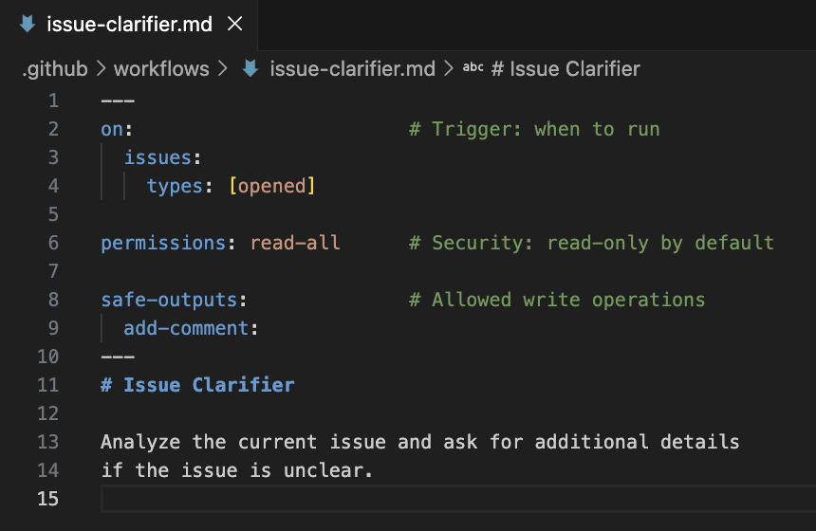
TECHNICAL PREVIEW
GitHub Agentic Workflows
Use frontmatter to define when a workflows runs and what it is allowed to read and write.
Required: Trigger configuration: on
Optional:
AI configuration: engine
Execution: jobs, concurrency, if
Capabilities: tools, imports, env
Metadata: name, description, label, source
Security & Access: permissions, network, safe-outputs
Runtime: runs-on, timeout-minutes, environment
See docs for a full frontmatter reference.
Notes:
GitHub Agentic workflow sources are markdown files.
At the top of the file, we define the frontmatter: the configuration block that defines when the workflow runs, what it can access and what it can modify.
The only required field is on, which (just like Action yaml) specifies the trigger event, such as when an issue is opened or a pull request is created.
Everything else is optional and grouped into categories:
AI configuration like engine, which selects the AI engine to use.
Execution controls like jobs, if, and concurrency, which control how the workflow runs.
Capabilities like tools, imports, and env, which define what the workflow can use.
Security settings like permissions, safe-outputs, and network, which limit what the workflow can read or write.
Runtime settings like runs-on and timeout-minutes, which define where and how long it runs.
In short, frontmatter makes workflows secure, controlled, and predictable by explicitly defining their behavior and access boundaries. This is not an exhaustive list, for more, please visit our full frontmatter reference, a great look up (for future reference) to see all possible choices at a glance!
Let’s look at an example (on RHS) for an “Issue Clarifier” agentic workflow:
We can see the frontmatter at the top of the file, defining that this workflows will run on opened issues, is read-only by default (agent) and will safely write by adding a comment to the issue.
But what about defining the agent instructions?

Slide 6
TECHNICAL PREVIEW
GitHub Agentic Workflows
Write simple markdown to declare your automation needs:
Write instructions in natural language. Markdown file *.md
Compile to validate and generate an executable workflow. Yaml file *.lock.yml
gh aw compile
MD
YML
Notes:
Most agent interfaces we know have text input as prompts, so it feels only natural that we have the same here. Hence, the rest if the file contains plain markdown, where we declare the AI agent out automation needs as natural language instructions.\
The ”Issue Clarifier” workflow (on RHS) shows how easy it is. We simply instructed the agent to analyze the current issue and clarify anything that is unclear.
To be executable, we need to compile this markdown with our GitHub Agentic Workflows CLI: gh aw compile Our source markdown file then gets transformed in a regular GitHub Actions yaml with our deterministic compiler and it is thus executable just like any other GitHub Action.
So now we have the intelligence (agent step) in place and brought into the CI/CD, what capabilities did we unlock that we did not have before?

Slide 7
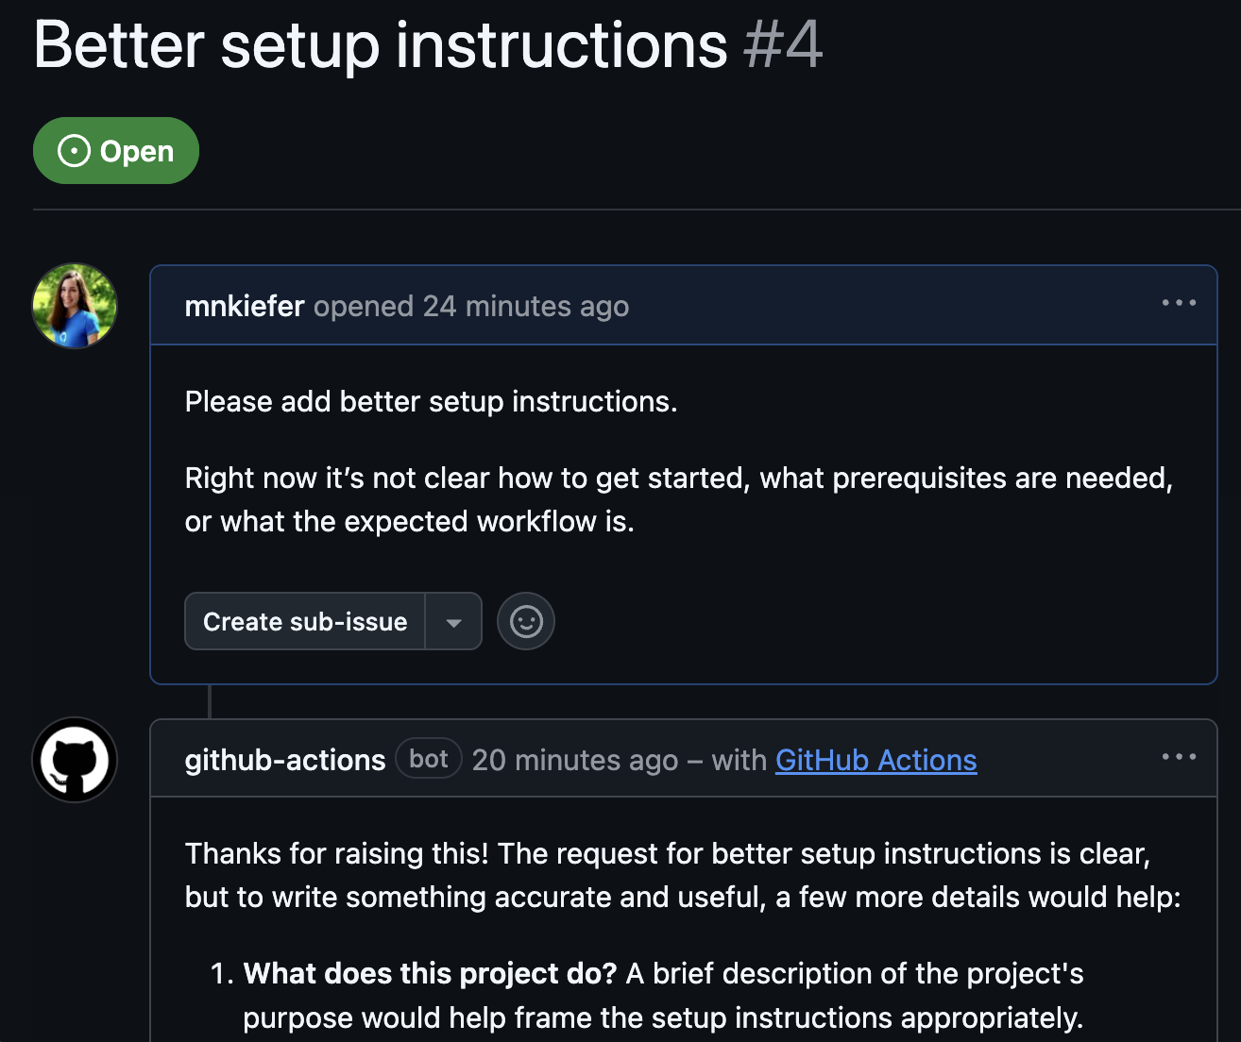




TECHNICAL PREVIEW
GitHub Agentic Workflows
With Agentic Workflows, your CI/CD can:
Understand context Read the repository, issues & pull requests, etc.
Make decisions Choose what to do based on the context not just predefined conditions.
Stay on course Understand concepts not just GitHub primitives.
Supported AI engines:
Notes:
With agentic workflows, we bring intelligence into CI/CD:
Instead of just reacting to predefined triggers, the workflow can understand context. It can read the repository, issues, pull requests, and related discussions to understand what is happening.
It can then make decisions based on that context, not just simple “if this, then that” conditions. It evaluates the situation and chooses the appropriate action.
It also stays on course by understanding the bigger concepts, not just GitHub events and it reasons about intent, impact, and completeness.
In short, we’ve made CI/CD become context-aware and decision-capable, rather than purely rule-driven.
But we’ve done it safely too…

Slide 8
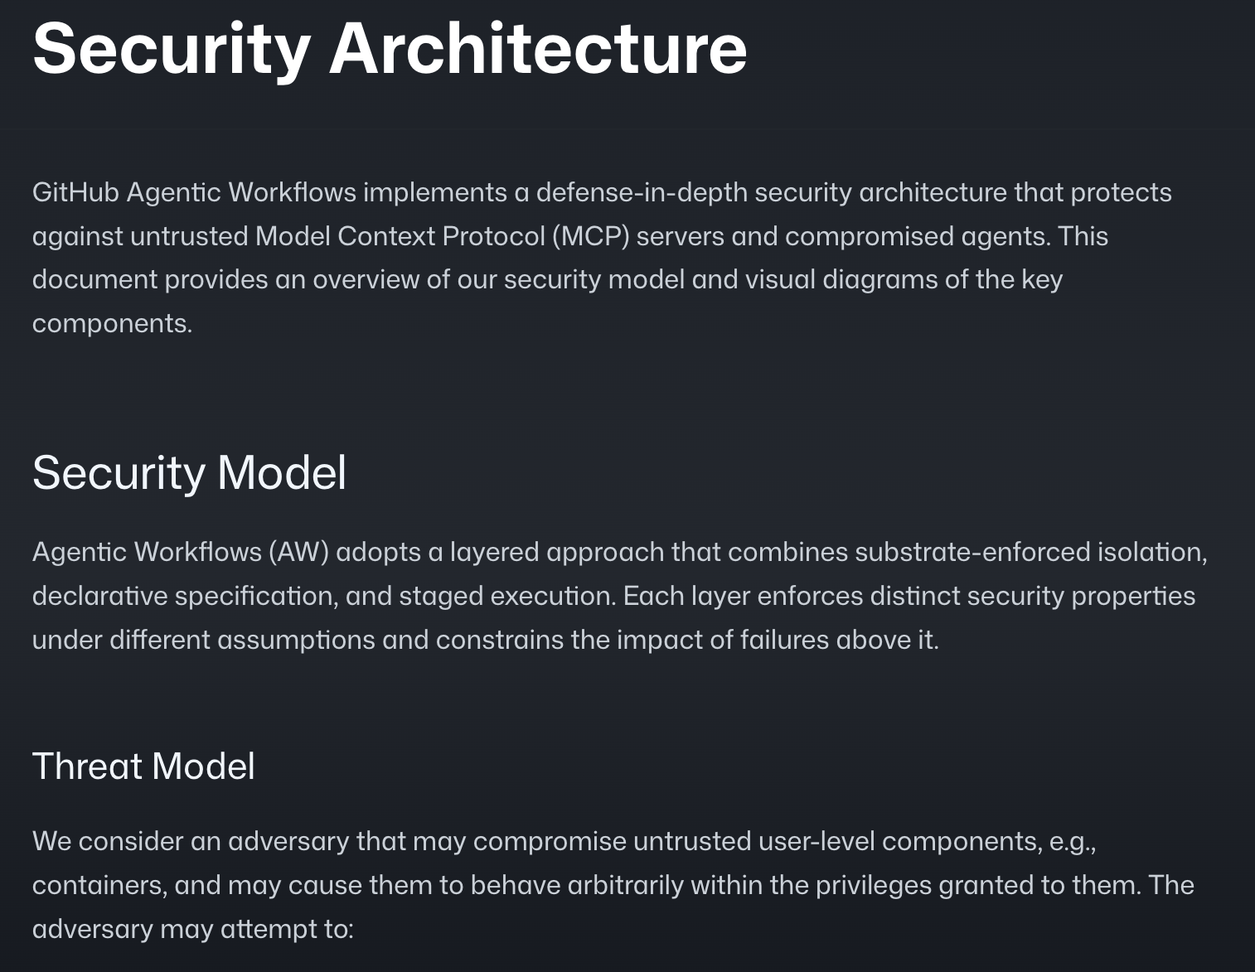
TECHNICAL PREVIEW
GitHub Agentic Workflows
Agentic Workflows put security first:
agent Has read-only permissions and only proposes actions.
detection Threat detection analyses scans the agent output for security issues.
safe outputs Run proposed actions in isolated containers.
Learn more by reading about our Security Architecture.
Notes:
Agentic workflows have been built with security as a priority (from day 1):
The agent runs with read-only permissions and does not directly make changes. Instead, it proposes actions based on what it understands.
Before anything happens, a threat detection analysis scans the agent’s output for potential security issues. This ensures the agent’s suggestions are safe before they are executed.
Proposed actions are then executed only in isolated containers using the safe outputs mechanism. This means that even if something goes wrong, it cannot affect the rest of the system.
In short, the workflow separates understanding, detection, and execution so that intelligence is safe and controlled.
For more details, you can read about the full security architecture in our reference documentation.
So now you know what an agentic workflow is, what it enables us to do. But we don’t just want to share the technology itself but also some learnings that we’ve derived from it and common patterns that we discovered by dog-fooding on ourselves excessively (really pushing the boundaries) and from working with design partners along the way…

Slide 9
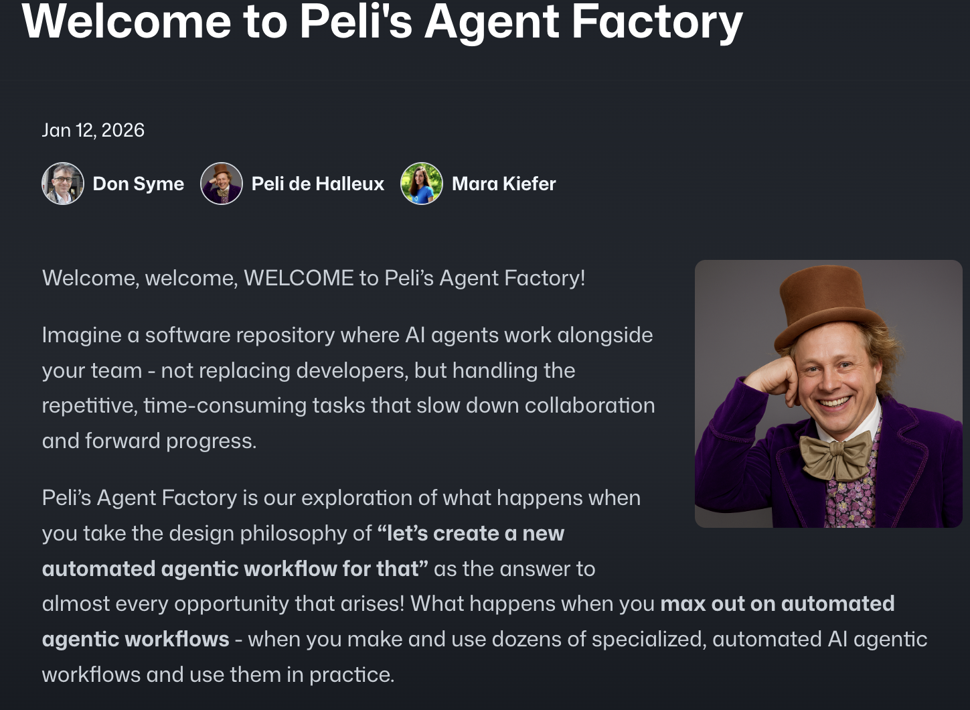
TECHNICAL PREVIEW
GitHub Agentic Workflows
Agentic Workflows are the building blocks of Continuous AI:
Reactive Intelligence (ChatOps · IssueOps) AI responds to issues, PRs & comments to triage, etc.
Continuous Improvement (DailyOps · TaskOps) Scheduled AI-driven analysis and incremental upgrades.
Insight & Governance (DataOps · ProjectOps) Analyze repository data and automatically update project state.
Orchestration (MultiRepoOps · CentralRepoOps) Coordinate work across repositories with centralized oversight.
And many more! Check out our ”Design Patters”.
Peli’s Agent Factory
Notes:
All of this led us to a series of design patterns which we’ve observed repeatedly so we documented them for you!
Seeing this evolve, we believe that Agentic Workflows are the building blocks of Continuous AI. The key shift is that AI is no longer used on demand as a one-off assistant — it operates continuously inside your software lifecycle. Instead of waiting for someone to manually trigger it, Continuous AI reacts in real time to issues, pull requests, and comments to triage, clarify, and guide discussions. It doesn’t just execute predefined rules; it understands context and makes informed decisions.
It also drives continuous improvement by running on schedules — analyzing code, identifying risks, suggesting enhancements, and applying incremental upgrades automatically. Beyond reactive and scheduled tasks, it provides insight and governance. It can analyze repository and project data, detect trends, surface risks, and automatically update project state to keep teams aligned.
At scale, it enables orchestration across multiple repositories with centralized oversight, coordinating work across systems rather than operating in isolation.
In short, Agentic Workflows are the execution layer, and Continuous AI is the broader vision: intelligent systems embedded directly into CI/CD — always observing, reasoning, and improving, not just responding when prompted.
Excited to get started?

Slide 10
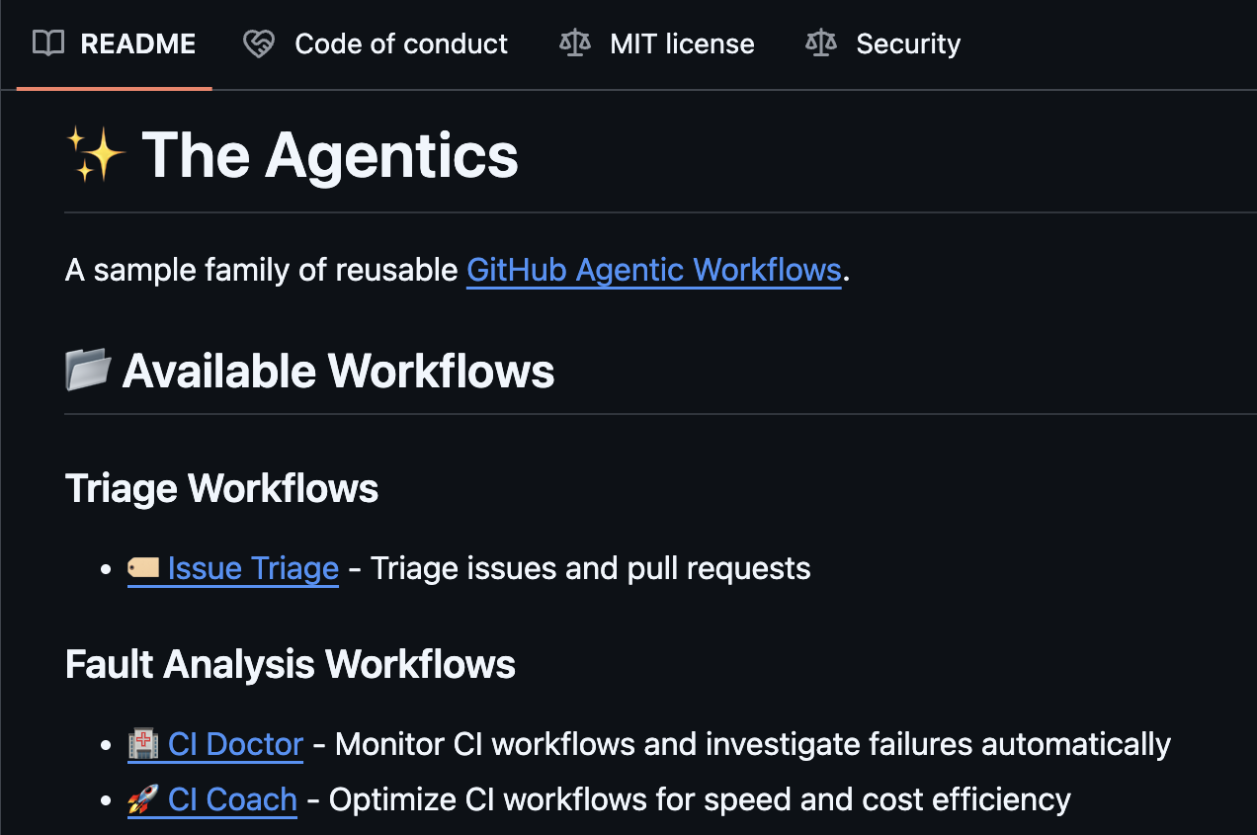
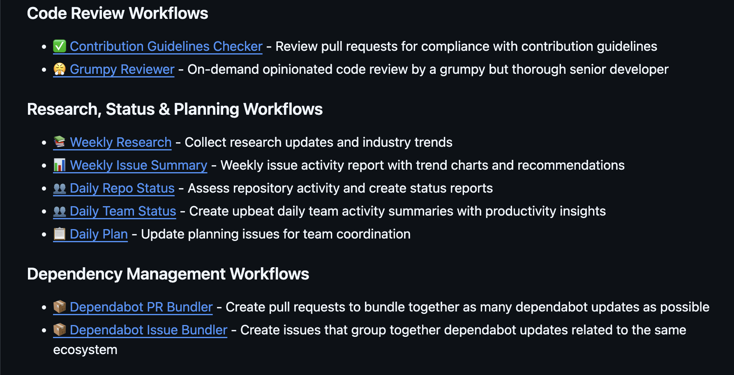
TECHNICAL PREVIEW
GitHub Agentic Workflows
Explore our agentics collection for inspiration.
Agentics
Notes:
If you’re looking for practical examples, explore our Agentics collection: This repository showcases real patterns and implementations of agentic workflows in action. It demonstrates how AI can be embedded into CI/CD to handle triage, automation, governance, and orchestration use cases.
Think of it as a design pattern library for Continuous AI. It provides inspiration, reference architectures, and concrete starting points you can adapt to your own repositories.
Rather than starting from scratch, you can explore proven approaches and see how agentic workflows are structured in real scenarios.
Speaking of real scenarios, let’s move onto the demos to see GitHub Agentic workflows in action!

Slide 11
Demo
Notes:
Demos:
(1) Installing our CLI and adding an Agentic Workflow (“Daily Repo Status”) to your repo from the Agentics collection.
(Like https://github.github.com/gh-aw/setup/quick-start/#adding-an-automated-daily-status-workflow-to-your-repo)
(2) Creating and editing Agentic Workflows directly from the web interface (via the agentic prompting experience).
(Like https://github.github.com/gh-aw/setup/creating-workflows/#github-web-interface)
(3) Real use case to meet enterprise demand: Rollout of an intelligent dependabot configuration across an entire org at scale.

Slide 12
Thank you
Notes:
Thank you for your attention! Any questions?
I’d also love to talk to you in the break. Please don’t hesitate to come up to me or if you prefer, drop me a message in LinkedIn.

